Slide 1

Framework for Artificial Intelligence in Quality Control of Suturing Among Undergraduates and Dermatology Residents
Department of Computer Science & Engineering
By
Shashank Shetgeri | 02fe24bcs413
Under the Guidance of
Dr. Salma Shahapur
Star Lab : C-ISHA

Slide 2

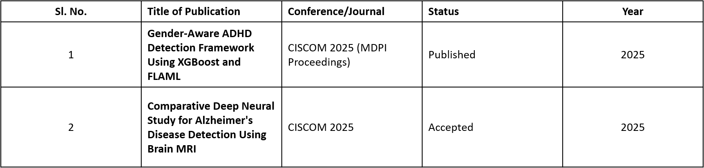
Academic Background
1)CGPA in Each semester
Semester | 3 | 4 | 5 | 6
Cumulative CGPA | 7.1 | 7.45 | 7.55 | 7.85
2) List of publications

Slide 3
Introduction
Introduction
Surgical suturing is a critical step in wound closure, where the quality of each stitch directly affects healing and patient safety. Manual assessment of suture quality can be subjective and time-consuming. This project presents an AI-powered framework that analyzes surgical images to automatically evaluate suture quality using multiple parameters, providing consistent and objective feedback to assist surgeons and improve surgical outcomes.
Motivation
Accurate suture evaluation is essential for successful wound healing, but manual inspection can be subjective and inconsistent. The motivation behind this project is to develop an AI-based solution that provides fast, reliable, and objective assessment of suture quality. By automating the evaluation process, the system aims to support surgeons in improving surgical precision, reducing errors, and enhancing patient outcomes.

Slide 4
Literature survey
Paper Title | Year and other details of paper | Methodology | Dataset | Gaps Identified
Improving Microsurgical Suture Training with Automated Phase Recognition and Skill Assessment via Deep Learning | 2025, Elsevier (Computers in Biology and Medicine) | Modified LRCN (CNN + LSTM) for phase recognition and skill assessment | Microsurgical suturing videos (11 surgeons: novice & expert) | Difficult to classify overlapping phases; limited number of surgeons.
From Precision to Strength: Computer Vision for Suture Quality Assessment—An Ex Vivo Pilot Study | 2025, Surgical Endoscopy | Computer vision + XGBoost to assess suture quality | Ex-vivo porcine rectal suturing dataset | Spatial features alone are not enough; poor prediction accuracy.
An Automated Skill Assessment Framework Based on Visual Motion Signals and a Deep Neural Network in Robot-Assisted Minimally Invasive Surgery | 2023, MDPI Sensors | KCF tracking + ResNet for automatic skill assessment | JIGSAWS dataset | Tested mainly on JIGSAWS; limited real-world validation.

Slide 5
Literature survey
Paper Title | Year and other details of paper | Methodology | Dataset | Gaps Identified
Evaluation of Objective Tools and Artificial Intelligence in Robotic Surgery Technical Skills Assessment: A Systematic Review | 2024, British Journal of Surgery | Systematic review of AI and objective assessment tools | Review of 247 published studies | Most AI tools are not clinically validated for routine use.
Competency Assessment Tool for Laparoscopic Suturing: Development and Reliability Evaluation | 2020, Surgical Endoscopy | Developed LS-CAT scoring tool using expert evaluation | Simulated laparoscopic suturing videos (36 performances) | Requires expert scoring; tested only in simulation.
Objective Assessment of Surgical Technical Skill and Competency in the Operating Room | 2017, Annual Review of Biomedical Engineering | Review of computer-aided surgical skill assessment methods | Review of 45 research papers | Lack of standard methods and limited operating-room validation.

Slide 6
Research problem and Objectives
Research Problem
Surgical suturing assessment remains subjective and inconsistent trainees rely on scarce expert feedback, limiting practice opportunities. AI could help, but existing approaches fail: they train on tiny datasets, offer no explanations for their scores, and lack real-world validation. Without a trustworthy, explainable AI framework, medical students cannot get the consistent, frequent feedback they need to master this essential skill.
Objectives
Extract quality images from raw 4K surgical training images using an adaptive, quality-aware frame extraction pipeline.
Build a multi-metric AI model that scores sutures across 6 quality dimensions ( ISD, Slack, Position, Angulation, Width) from a single image.
Quantify prediction uncertainty so surgeons know when to trust the AI and when to override it.
Explain every score with visual heatmaps showing what drove each metric

Slide 7
Tool learning
Tools & Platforms
1)Language: Python 3.11+
2)Video Processing: OpenCV (frame extraction, quality analysis)
3)Deep Learning: PyTorch (model building, training, inference)
4)Data Handling: pandas, NumPy, scikit-image (SSIM), 5)transformsVisualization: Matplotlib, Seaborn

Slide 8
Experimental Setup
Component | Specification
Processor | AMD Ryzen 7 4800H (8 cores, 2.9 GHz)
RAM | 16 GB
GPU | NVIDIA GeForce GTX 1650 Ti (4 GB VRAM)
CUDA Version | 13.2 / Driver 595.97

Slide 9
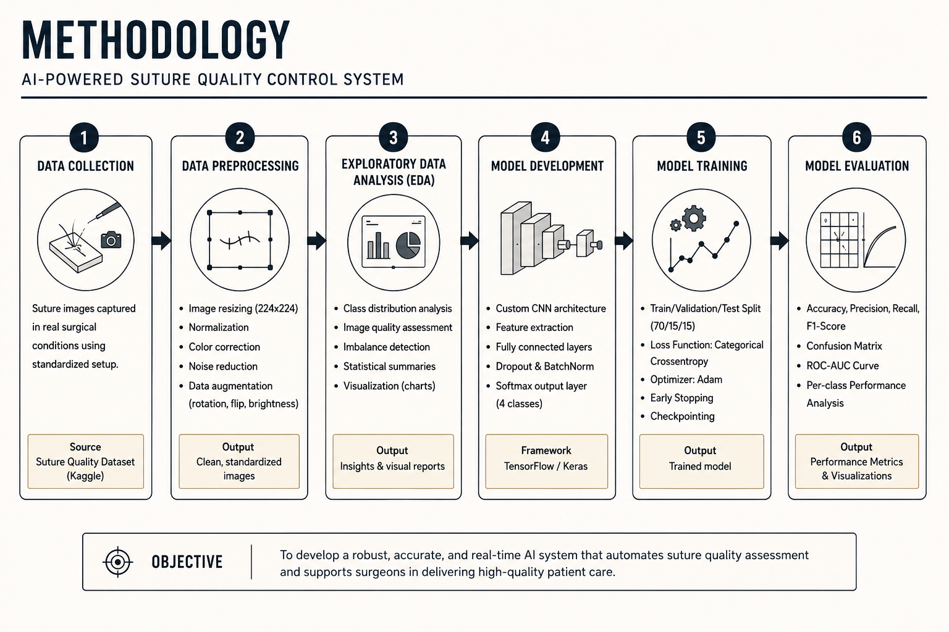

Slide 10
Roadmap
Month | June/July | Augest | September | October | November | December
Literature review
PreProcessing and Feature Extraction
Model Development and classification
Evaluation and analysis

Slide 11
References
Khalil, S., Shah, H. A., & Bednarik, R. (2025). Improving microsurgical suture training with automated phase recognition and skill assessment via deep learning. Computers in Biology and Medicine, 192:110238. https://doi.org/10.1016/j.compbiomed.2025.110238 (ScienceDirect)
Spagnulo, R., Marzola, F., Corso, F., et al. (2025). From precision to strength: computer vision for suture quality assessment—an ex vivo pilot study. Surgical Endoscopy. https://doi.org/10.1007/s00464-025-12441-6 (Springer)
Pan, M., Li, X., Huang, J., et al. (2023). An automated skill assessment framework based on visual motion tracking and deep learning in robot-assisted minimally invasive surgery. Sensors (Basel), 23(9):4496. https://doi.org/10.3390/s23094496 (MDPI)
Kankanamge, D., Wijeweera, C., Ong, Z., et al. (2025). Artificial intelligence based assessment of minimally invasive surgical skills using standardized objective metrics – a narrative review. American Journal of Surgery, 241. https://doi.org/10.1016/j.amjsurg.2024.116074 (ScienceDirect)
Boal, M.W.E., et al. (2024). Evaluation of objective tools and artificial intelligence in robotic surgery: a systematic review. British Journal of Surgery (BJS), 111(1). https://doi.org/10.1093/bjs/znad331 (OUP Academic)
Shayan, A.M., Singh, S., Gao, J., et al. (2023). Measuring hand movement for suturing skill assessment: a simulation-based study. Surgery, 174:1184–1192. https://doi.org/10.1016/j.surg.2023.07.007 (classicaproject.eu)

Slide 12
References
7) Vedula, S.S., Ishii, M., & Hager, G.D. (2017). Objective assessment of surgical technical skill and competency in the operating room. Annual Review of Biomedical Engineering, 19:301–325. https://doi.org/10.1146/annurev-bioeng-071516-044435 (classicaproject.eu)
8) IJgosse, W.M., Leijte, E., & Botden, S.M.B.I. (2020). Competency assessment tool for laparoscopic suturing: development and reliability evaluation. Surgical Endoscopy, 34:2947–2953. https://doi.org/10.1007/s00464-019-07077-2 (classicaproject.eu)
9) Mintz, Y., & Brodie, R. (2019). Introduction to artificial intelligence in medicine. Minimally Invasive Therapy & Allied Technologies, 28:73–81. https://doi.org/10.1080/13645706.2019.1575882 (classicaproject.eu)
10) Zhao, Z., Chen, Z., Voros, S., & Cheng, X. (2019). Real-time tracking of surgical instruments based on spatio-temporal context and deep learning. Computer Assisted Surgery, 24(Suppl 1):20–29. https://doi.org/10.1080/24699322.2018.1560097 (ouci.dntb.gov.ua)

Slide 13
Thank you !

